Slide 1

PROTECTION OF WOMEN FROM DOMESTIC
VIOLENCE ACT, 2005
By Ms. Geeta Luthra, Senior Advocate, Supreme Court of India, Member – International Association of Family Lawyers (IAML), Vice President – Indian Council for Arbitration and Member - ICC
“Injustice anywhere is a threat to justice everywhere. We are caught in an inescapable network of mutuality, tied in a single garment of destiny. Whatever affects one directly, affects all indirectly.”
- Martin Luther King Jr.
Enacted for the effective protection of the rights of the women guaranteed under the Constitution.
This act was passed by the Parliament in August 2005, and came into force from October 26, 2006.
The act provides for the first time in Indian law a definition of “domestic violence”, which includes not only physical violence but also emotional, sexual and economic abuse.

Slide 2


THE CURRENT SCENARIO
(SHOCKING!!!)
The National Commission for Women (NCW), which receives complaints of domestic violence from across the country, has recorded more than twofold rise in gender-based violence in the national Coronavirus lockdown period. The total complaints from women rose from 116 in the first week of March (March 2-8), to 257 in the final week (March 23-April 1).
“Domestic violence cases have doubled than what it was before the lockdown. The cases of domestic violence are high in Uttar Pradesh, Bihar, Haryana and Punjab,” says NCW chief Rekha Sharma. She says the main reason for the rise of domestic violence is that the men are at home and they are taking out their frustration on women and they refuse to participate in domestic work. Women are also confined within the four walls of the house and they cannot share their grief with anybody.

Slide 3
THE GLOBAL CRISIS DUE TO COVID - 19
The United Nations called on Sunday for urgent action to combat the worldwide surge in domestic violence. “I urge all governments to put women’s safety first as they respond to the pandemic,” Secretary General António Guterres wrote on Twitter.
In China, a Beijing-based NGO dedicated to combating violence against women, Equality, has seen a surge in calls to its help line since early February, when the government locked down cities in Hubei Province, then the outbreak’s epicenter.
Domestic violence rates have surged in France and South Africa, according to Voice of America. In South Africa, authorities said there were nearly 90,000 reports of violence against women in the first week of a lockdown.
In Australia — where the government has promised some $91 million to address the problem as part of its COVID-19 response plan — Google reports a 75% increase in online searches for help with domestic violence.
In Spain – where lockdown rules are extremely strict, and many people are being fined for breaking them – the government has told women they will not be fined if they leave home to report abuse.

Slide 4
PRE – PWDVA SCENARIO
The only legal remedies available to women against violence at the hands of her husband / partner / in-laws before PWDV Act came into existence were:
Section 498A Indian Penal Code, 1860
Conditions to satisfy a crime under this section includes acts which would be likely to drive a woman or drove a woman to commit suicide or cause grave danger to her life and limb or health.
Section 304B, Indian Penal Code, 1860
This could only be used post-mortem to punish violence against a woman when the cause of her death has been shown to be dowry related.

Slide 5
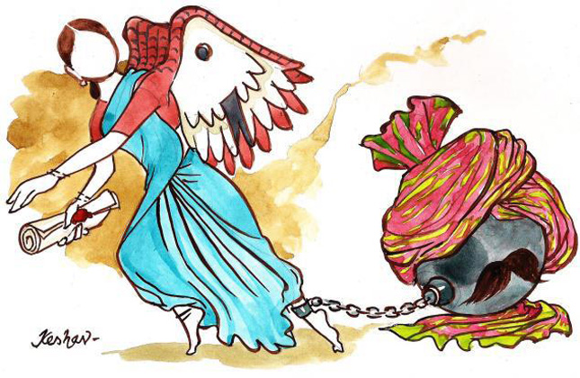
SINGLE WINDOW ACT TO EMPOWER WOMEN
Prior to its enactment, there was no statutory protection providing protection to women in the matrimonial home. The act is a single window act to empower women who may be a victim of physical, verbal, sexual or economic abuse.
According to the National Crime Record Bureau, total of 50,74,634 cognizable crimes, comprising 31,32,954 IPC and 19,41,680 Special and Local Laws (SLL) crimes, were registered in 2018.
Out of the total crimes registered under the Indian Penal Code (IPC) against the women, the majority of the cases were registered under the 'cruelty by husband or his relatives' at 31.9%.

Slide 6
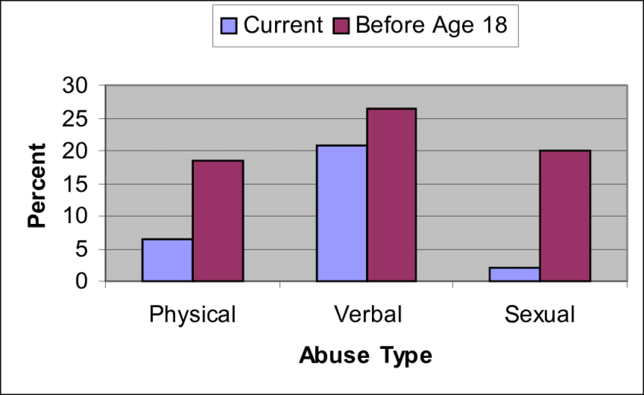
RECENT SURVEY OF TYPES OF DOMESTIC ABUSES SUFFERED BY WOMEN ON A DAILY BASIS

Slide 7

A CIVIL LAW
The law which provides compensation and remedies to the victim is termed as a civil law.
PWDVA 2005 is directed towards providing compensation and support to women victim and not just to penalize the perpetrator.
This is the law which is victim driven and the state is not required to initiate it. For example, in the proceedings under Section 498A, the state is a party and the victim has to depend on the police and prosecution for enforcement.
It can be put in to motion by the aggrieved by direct access to the court claiming relief.
Another aspect for conceptualizing it as a civil law is that it restores the agency that rightly belongs to her, redefines the injury so as to perceive her to be injure.

Slide 8
RECENT DEVELOPMENTS IN THE FIELD OF DOMESTIC VIOLENCE BY JUDICIAL PRONOUNCEMENTS

Slide 9
Aggrieved wife may also file a complaint against a relative of the husband or the male partner, as the case may be
Ajay Kumar v. Lata alias Sharuti
AIR 2019 SC 2600
Decided on 8th April 2019 by Hon’ble Justice Dr. D.Y. Chandrachud and Hon’ble Justice Mr. Hemant Gupta
It was held that the proviso to Section 2(q) of the Protection of Women from Domestic Violence Act, 2005, indicates that both, an aggrieved wife or a female living in a relationship in the nature of marriage may file a complaint against a relative of the husband or the male partner, as the case may be.

Slide 10
Domestic Violence vs. Section 125 CrPC – Both are independent proceedings
P. Rajkumar v. Yoga @ Yogalakshmi
Criminal Appeal No. 1613 of 2019
Decided on 23rd October 2019 by Hon’ble Justice Mr. Navin Sinha and Hon’ble Justice Mr. B.R. Gavai
The Supreme Court of India has made significant observation that the proceedings under the PWDVA 2005 and under Section 125 Cr.P.C. are independent proceedings. Once the Ld. Magistrate declined to grant maintenance under the PWDVA, it was not open for him to assume jurisdiction in a proceedings under Section 125 Cr.P.C. which was not pending before him and was a completely independent proceeding to direct grant of maintenance under the same.

Slide 11
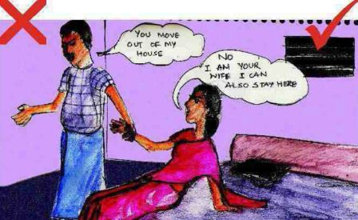
Misinterpretation of loosely defined terms like “matrimonial home”
The definition of “matrimonial home” and “shared household” was too loosely defined in the Protection of Women from Domestic Violence Act in Sec 17 of Domestic Violence Act where even a temporary residence/visit could have been interpreted to include matrimonial home. The concept has been narrowed down by the Delhi High Court in three land mark judgments namely:
Shumita Didi Sandhu v. Sanjay Singh Sandhu, (2007) 96 DRJ 697
Dr. Kavita Chaudhri v. Ms. Eveneet Singh & Anr., Ex. P. 180/2011 & E.A. No. 197/2012
Barun Nahar v. Parul Nahar, 2013 (2) AD (Delhi) 517

Slide 12
Interpretation of “Shared Household”
Barun Nahar v. Parul Nahar, 2013 (2) AD (Delhi) 517
It was the case of the Plaintiff that the father-in-law is the sole and absolute owner of the property bearing No. B – 197, Greater Kailash, Part – 1, New Delhi consisting of ground and first floor. Further, the said property was purchased by him vide sale deed dated 10.8.1971 through his own funds and since then he and his wife were residing in the same property. Further, he and his wife were aged around 80 years and 74 years respectively and were suffering from various old age ailments.
It was held by the Hon’ble Court that a daughter-in-law has no right to reside in the subject property which belongs to her father-in-law as the said property is not covered by the definition of 'shared household', the same being neither a joint family property in which her husband is a member.
The legal position which can be culled out is that a daughter-in-law has no right to continue to occupy the self acquired property of her parents-in-law against their wishes more so when her husband has no independent right therein nor is living there.
Similar observations were made in Eveneet Singh v. Prashant Chaudhari & Anr., 2011 SCC OnLine Del 4651; CS (OS) 505/2010 Delhi High Court.

Slide 13


Ambit of “Shared Household”
Sneha Ahuja v. Satish Chander Ahuja (December 2019)
S.R. Batra & Anr. v. Taruna Batra, (2007) 3 SCC 169
It has been categorically held that a shared household solely refers to the house belonging to / taken on rent by the husband or the house belonging to a joint family, of which the husband is a member. Therefore, as per the prevalent law, any property owned exclusively by an in-law cannot be treated as a shared household.

Slide 14
MISUSE – EASY TOOL FOR TORTURE
A married woman can be subjected to cruelty by her husband or his relatives (Section 498A), or by her husband and his relatives for demands of dowry preceding unnatural death within seven years of marriage (Section 304B), or causing her death amounting to murder (Section 302). In both, Sections 498A and 304B, cruelty extends toward death.
A person charged under Section 304B, Indian Penal Code, 1860 can be convicted under Section 498A, Indian Penal Code, 1860 without any charge under that section.
According to the Malimath Committee Report (237th Law Commission Report), once a complaint or FIR is lodged under Section 498A, Indian Penal Code, 1860 or Section 406, Indian Penal Code, 1860, it becomes an easy tool in the hands of the police to arrest or threaten to arrest the husband and other relatives named in the complaint / FIR without even considering the intrinsic worth of allegations and making a preliminary investigation.

Slide 15


There are various issues related with substantive and procedural or conceptual loopholes / hurdles which raised queries regarding effective implementation:
Lack of evaluating and monitoring assessment of success and failure of previous social legislations.
For-Women and Anti-Men (Monomaniac Legislation)
Substantive lacunas / loop holes in over-empowering the Authorities.
Procedural lacunas.
Services related technicalities.
Too many rights and reliefs without practical assessment.
Not avoided the possibility of misuse

Slide 16


Domestic Violence vs. Senior Citizens Act
Vinay Varma v. Kanika Pasricha
CM (M) 1582/2018
Decided on 29th November, 2019 by Hon’ble Justice Prathiba M. Singh
The Court / Tribunal has to first ascertain the nature of the relationship between the parties.
If the case involves eviction of a daughter-in-law, the Court has to also ascertain whether the daughter-in-law was living as part of a joint family.
If the relationship between the parents and the son are peaceful or if the parents are seen colluding with their son, then, an obligation to maintain and to provide for the shelter for the daughter-in-law.
In such a situation, while parents would be entitled to seek eviction of the daughter-in-law from their property, an alternative reasonable accommodation would have to be provided to her.
If the son has abandoned both the parents and his own wife / children, then if the son’s family was living as part of a joint family prior to the breakdown of relationships, the parents would be entitled to seek possession from their daughter-in-law, however, for a reasonable period they would have to provide some shelter to the daughter-in-law during which time she is able to seek her remedies against her husband.

Slide 17
NOT ALL LIVE-IN RELATIONSHIPS ARE COVERED UNDER THE ACT
Indra Sarma v. V.K.V. Sarma
(2013) 15 SCC 755
Decided on 26th November, 2013 by Hon’ble Justice K.S.P. Radhakrishnan and Hon’ble Justice P.C. Ghose
Relationship defined as “Relationship in the nature of marriage”
A partner in a live-in relationship is eligible to seek maintenance under the provisions of the Protection of Women from Domestic Violence Act, 2005.
The couple must hold themselves out to society as being akin to spouses.
They must be of legal age of marry.
They must be otherwise qualified to enter into a legal marriage
They must have voluntarily cohabited and held themselves out to the world as being akin to spouses for a significant period of time. husband.

Slide 18

(Not all live-in relationships are covered under the Act)
Are there LOOPHOLES?
The legislation covers all women in abusive relationships, regardless of whether the person responsible for is a spouse, domestic partner, or someone in a live-in relationship. It also protects unmarried women, siblings, and other women living with the alleged perpetrator.
Unfortunately, according to the Act, the aggrieved party is always “any woman”. “Man” does not come within the purview of such definition. Thus, the aggrieved under the Act can only be a woman. Even the preamble speaks for the “rights of woman”.
Provisions like Section 20(l)(d) can be misused when we consider that a female partner in a live-in relationship that may have only lasted for a month can claim maintenance allowance under this provision, with no restrictions attached.

Slide 19
REMEDY / RELIEF UNDER TWO UMBRELLAS?
Rachna Kathuria v. Ramesh Kathuria
Crl. M.C. No. 130/2010
Decided on 30th August, 2010 by Hon’ble Justice Dhingra
If a woman has already moved the Court and her right of maintenance has been adjudicated by a competent Civil Court or by a competent Court of MM under Section 125 Cr.P.C., for any enhancement of the maintenance already granted, she will have to move the same Court and she cannot approach the MM under the Protection of Women from Domestic Violence Act by way of an application of interim or final nature to grant additional maintenance.
Similar observations were made in Shome Nikhil Danani vs. Tanya Banon Danani, Crl. Rev. P. No. 994/2018, Delhi High Court.

Slide 20
THE LEGISLATION – COMPARISION OF ITS IMPLEMENTATION
INDIA | UNITED KINGDOM | UNITED STATES OF AMERICA
Does not recognize domestic violence against men. The female to male ratio of police complaints is likely to be worse than 99:1 | The definition of Domestic violence is wide covering all forms of abuse, and victims of abuse are identified as both men and women as well as those in the same sex relationships. In terms of police statistics, while there are more alleged female than male victims, the ratio is 65:35. | Violence Against Women Act, (VAWA)1994, 2000, 2005, Family Violence Prevention and Services Act, Domestic Violence Offender Gun Ban. Definition of violence inclusive of both men and women. 1 in 3 women and 1 in 4 men have been victims of [some form of] physical violence by an intimate partner within their lifetime.
Does not recognize Marital Rape but ironically recognizes sexual/physical/mental crimes against women by men. | The exemption for marital rape was abolished in 1991. | Marital Rape is illegal in all States of United States of America.
Does not recognize custody of children to be with the father. Inclination of female child’s custody to be with mother | No presumption for or against “joint custody” of child/children. No gender related presumptions. | Gender neutral, inclination towards best interest of child.
No clarity on whether the statute is Criminal in nature or Civil. | Criminal in nature. There are no separate laws or separate penalties for any conduct within the relationship, different from such conduct outside of relationship. It is a common sense law. | All the federal domestic violence crimes are felonies.

Slide 21


ESSENTIAL CONDITIONS FOR GRANTING MAINTENANCE
Sufficient means to maintain – According to Section 125(1) of the Code of Criminal Procedure, the person from whom maintenance is claimed must have sufficient means to maintain the person or persons claiming maintenance.
Neglect or refusal to maintain – As per Section 125(1) of the Code of Criminal Procedure, the person from whom maintenance is claimed must have neglected or refused to maintain the person or persons entitled to claim maintenance.
Wife claiming maintenance must be unable to maintain herself – As the object of Section 125 of the Code is mainly to prevent vagrancy, the requirement to pay maintenance should be only in respect of persons who are unable to maintain themselves. The maintenance has to be determined in the light of the standard of living of the person concerned which she enjoyed at the place of her husband.

Slide 22
WHAT IF NOT EARNING MEANS “DELIBERATELY NOT WORKING, BUT CAPABLE”?
Whether a spouse who has the capacity of earning but chooses to remain idle should be permitted to saddle the other spouse with his or her expenditure?
Smt. Mamta Jaiswal v. Rajesh Jaiswal, 2000 (3) MPLJ 100
A spouse who is well qualified to get the service immediately with less efforts is not expected to remain idle to squeeze out, to milk out the other spouse by relieving him of his or her own purse by a cut in the nature of pendente life alimony.
Section 24 is not meant for creating an army of such idle persons who would be sitting idle waiting for a ‘dole’ to be awarded by her husband who has got a grievance against her and who has gone to the Court for seeking a relief against her.
“No maintenance to well qualified and capable wife!”
Shailja & Anr. v. Khobanna, (2018) 12 SCC 199
Merely because the wife is capable of earning it is not a reason to reduce the maintenance awarded to her and said that whether a wife is capable of earning and is actually earning are two different factors.

Slide 23
QUANTUM OF MAINTENANCE TO BE DECIDED… HOW?
Annurita Vohra v. Sandeep Vohra, 2004 (74) DRJ 99
The Court must first arrive at the net disposable income of the husband or the dominant earning spouse. If the other spouse is also working these earnings must be kept in mind. This would constitute the ‘Family Resource Cake’ which would then be cut up and distributed amongst the members of the family. The apportionment of the cake must be in consonance with the financial requirements of the family members.
No set formula can be laid for fixing the amount of maintenance. It has, in the very nature of things, to depend on the facts and circumstances of each case. Some scope for leverage can, however, be always there. The Court has to consider the status of the parties, their respective needs, the capacity of the husband to pay having regard to his reasonable expenses for his own maintenance and of those he is obliged under the law and statutory but involuntary payments or deductions.
A satisfactory approach would be to divide the Family Resource Cake in two portions to the husband since he has to incur extra expenses in the course of making his earning, and one share each to other members.

Slide 24


Apex Court and Its Observation on Quantum
Kalyan Dey Chowdhury v. Rita Dey Chowdhury Nee Nandy
Civil Appeal No. 5369 of 2017
The Hon’ble Supreme Court held that 25% of the husband’s net salary would be just and proper as maintenance to wife.
Reference was made to Dr. Kulbhushan v. Raj Kumari & Anr., 1970 (3) SCC 129 wherein it was held that 25% of the husband’s net salary would be just and proper to be awarded as maintenance to the respondent-wife.
Other remarkable observations which were made by the Court were:
The amount of permanent alimony awarded to the wife must be befitting the status of the parties and the capacity of the spouse to pay maintenance.
That maintenance is always dependant on the factual situation of the case and the Court would be justified in moulding the claim for maintenance passed on various factors.

Slide 25

MAINTENANCE – IF SUPPRESSION OF FACTS?
Suppression must be of a material fact.
The court has to consider “suppression” in its entirety and not by resorting to hairsplitting.
If the explanation is bonafide, the party is not required to face dismissal of the claim.
There are various judgments where the Courts have observed that when there is suppression of facts, maintenance ought to be reduced…however, this is fatal..
P. Suresh v. Smt. S. Deepa, Karnartaka High Court
Arun Kumar v. Meenu Kumar, (2012) 194 DLT 757
And if suppression of facts by the wife.. She should not be entitled to receive any amount of maintenance.

Slide 26
GROUNDS ON WHICH THE WIFE CAN BE REFUSED MAINTENANCE
WIFE MUST NOT BE LIVING IN ADULTERY
As per Section 125(4) of the Code of Criminal Procedure, no wife shall be entitled to receive an allowance for the maintenance or the interim maintenance and expenses of proceeding, as the case may be, from her husband under Section 125 if she is living in adultery.
WIFE MUST NOT REFUSE WITHOUT SUFFICIENT REASONS TO LIVE WITH HER HUSBAND
According to Section 125(4) of the Code of Criminal Procedure, no wife shall be entitled to receive an allowance for the maintenance from her husband, if she refuses to live with her Husband, or if they are living separately by mutual consent.
As per explanation to Section 125(3) of the Code, if a husband has contracted marriage with another woman or keeps a mistress, it shall be considered to be a just ground for his wife’s refusal to live with him.
As per explanation to Section 125(3) of the Code, if a husband has contracted marriage with another woman or keeps a mistress, it shall be considered to be a just ground for his wife’s refusal to live with him.

Slide 27
COMMON MISCONCEPTIONS IN ADDRESSING DOMESTIC VIOLENCE IN CHILD CUSTODY DISPUTES
MISCONCEPTION NO. 1 – Domestic violence is rarely a problem for divorcing couples involved in a child custody dispute.
Reality – Majority of parents in “high-conflict divorces” involving child custody disputes report a history of domestic violence.
MISCONCEPTION NO. 2 – Domestic violence ends with separation for abused women.
Reality – Abused women often face continuing risks from their partner after separation.
MISCONCEPTION NO. 3 – As long as children are not abused directly, they are not harmed by exposure to domestic violence.
Reality – Children exposed to domestic violence may suffer from significant emotional and behavioral problems related to this traumatic experience.

Slide 28

CUSTODY – ONLY WITH THE WIFE – THE LACK OF CLARITY
“The assumption that a mother keeps the home, performs household duties, and will have more time to devote to the children and their welfare” was simply not true for many mothers.
Even the Courts articulating the best interests standard often hewed to the unwritten presumption that “the interests of children of tender years will be best served when they are in the custody of their mother”.
FROM THE RULE OF ONE TO THE SHARING OF CUSTODY – In light of these permutations, the joint custody – sole custody distinction is best viewed along a continuum, not as a sharp divide. Most states distinguish between joint legal and joint physical custody.

Slide 29

CONCLUSION
The Act presently is heavily in favor of women. Although, the chances of it being misused and abused though enormous are being constructively and considerably reduced through progressive and definitive judicial review by the Indian Courts.
This Act should have ideally included stringent penal provisions for curtailing the instances of abuse and mishandling. Also, this Act does not contain any provisions for creating awareness or for strengthening and preserving family as an institution or even providing chances for reconciliation or even scope for improvement to “the husband”.
It is eventually, the neo collectivist and neo socialist approach which is needed in the society that can essentially free both men and women from shackles of brutality and ultimately put them on an equal pedestal in all respects. Only in a more gender-equal society, women who have suffered violence could get rid of shame/self-blame and such happenings could be de-stigmatized. Family, school, peer groups, and media are all agencies of socialization, which all together should join the cultural revolution and mental revolution to construct India a more female-friendly society.

