Slide 1
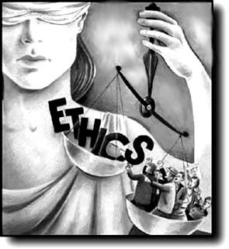
PRESENTATION
ON
ETHICS OF LEGAL PROFESSION
From- Abhishek Garg
Roll No. – 1
Class –LL.B (6th semester)

Slide 2

Introduction
The profession of law is honourable, and its members are expected to act in an honest and upright manner, and any deviation from these elementary principles is liable to dealt with severely.

Slide 3
Importance of Legal profession
Legal profession is not a business but a profession. It has been created by the state for the public good. Consequently, the essence of the profession lies in the three things-
Organisation of its members for the performance of their function;
Maintenance of certain standards, intellectual and ethical for the dignity of the profession;
Subordination of pecuniary gains to efficient services.

Slide 4

Advocates Act, 1961
To maintain the honour of the Legal profession the Advocate Act has been passed & the Bar Councils have been established.

Slide 5
Various provisions under Advocate Act, 1961
Sec. 3(1) provides for establishment of state Bar Council for various states & union territories.
Sec. 9 states that every Bar Council shall constitute one or more disciplinary committee.
Sec. 7 lays down functions of Bar Council of India.

Slide 6
Functions of Bar Council of India
To lay down standards of professional conduct and etiquette for advocates;
To lay down the procedure to be followed by its disciplinary committee and the disciplinary committee of each State Bar Council;
To safeguard the rights, privileges and interests of advocates;
To exercise general supervision and control over State Bar Councils; etc.

Slide 7
Functions of State Bar Council (Sec. 6)
To admit persons as advocates on its roll;
To entertain and determine cases of misconduct against advocates on its roll;
To safeguard the rights, privileges and interests of advocates on its roll;
To promote and support law reform;
To manage and invest the funds of the Bar Council;
To provide for the election of its members; etc.

Slide 8
Power of disciplinary committee
(Sec. 42 of Advocates Act ,1961)
The disciplinary committee of a Bar Council shall have the same powers as are vested in a civil court under the Code of Civil Procedure, 1908 (5 of 1908).
All proceedings before a disciplinary committee of a Bar Council shall be deemed to be judicial proceedings.
No such proceedings shall be invalid merely by reason of the absence of the Chairman or member thereof on any such date of disciplinary proceeding.

Slide 9
Section 49(1)(c) of The Advocates Act
Empowers the Bar Council of India to make rules
To prescribe the standards of professional conduct and etiquette to be observed by the advocates.
Such rules shall have effect only when they are approved by the Chief Justice of India.

Slide 10
Standard of conduct and etiquette of the Bar
Exercise of its rule making power under Sec. 49(1)(c) of 1961, the Bar Council of India has framed standard of conduct and etiquette of the Bar. They are as follows:-
In no circumstances may a lawyer be a party to a breach of the law.
He must not abuse the process of the court in order to injure the opponent or to benefit himself.
When appearing as an advocate, he must disclose to the court any relevant legislation or cases of which he is aware.
He must not be a party to the fabrication of false evidence.

Slide 11
Continued....
A lawyer must not vary his fees according to the success or failure of the cause.
A lawyer must not solicit business , advertise himself either directly or indirectly.
A lawyer must devote himself entirely to his client's interest. He must disclose any personal interest inconsistent with the client's interest, and he cannot represent two or more clients whose interest conflict.
A lawyer must not, except with the clients consent, at any time disclose confidential information or use it otherwise than on behalf of the client.
A lawyer must make every legitimate effort to win his client's case, and must not exercise a private judgment as to the soundness of any reasonable arguments or the propriety of any client or defence allowed by the law

Slide 12
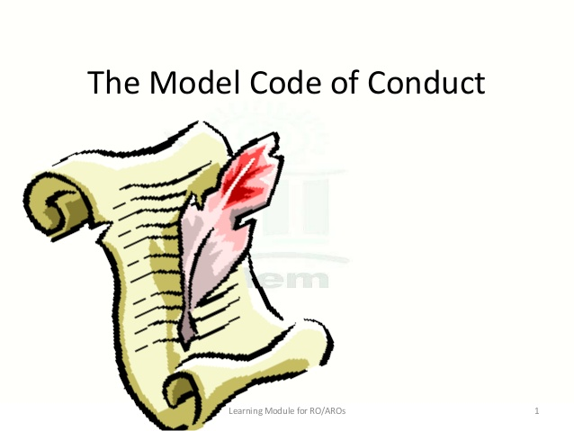
Continued....
A lawyer should not allow a client to entertain false hopes of success in litigation, and where success is doubtful, should make the position clear to him
A lawyer owes a duty to the opponent not to use unfair methods against him. (Eg. attacks on the reputation)

Slide 13
Duty towards Court
1. Advocate is an officer of justice and friend of the Court- His status as an officer of justice does not mean he is subordinate to the judge. It only means that he is an integral part of the machinery for the administration of justice.
2. Co-operation between the bench and the Bar is a necessity:-the first duty which advocates and judges owe to each other is of co-operation. Co-operation between the bench and the Bar is not a mere conventional statement. It is a fundamental necessity. Without it, there can be no orderly administration of justice.

Slide 14
Other Etiquette of the Profession
The advocate should not display temper in court. He will not indulge in any kind of insinuation in the court against the judge. He should convince the judge by argument and reason and not by appeal to his sentiments.
The advocate must not do anything which lowers public confidence in the administration of justice.
The advocate must not do anything which is calculated to obstruct, divert or corrupt the stream of justice, for instance, he must not advise disobedience to the courts order and decrees.
Advocate must not deceive the court.
Advocate must not attempt to influence private influence upon the judge.
Lawyers are not subordinate officers of the Court.

Slide 15
Obligations of Advocates
1 .Counsel's obligation in respect of witnesses: In examining witnesses advocate should not forget that he is not merely the counsel of client but also an officer of the court to further the ends of justice. He must not disregard the feeling of witnesses, or embarrass or bully them. He should not be sarcastic. He should not assume that all witnesses are liars to be treated alike.
2. The advocate must not misuse the privilege of cross examination: This privilege like any other privileges, should only be used for the purpose intended, and should not be abused from sinister motives. A party may impeach the credit of a witness called by him only if he turns hostile and that too with the leave of the court.
3. He must not tutor his witnesses

Slide 16
Continued.....
4. The advocate must not tamper with witnesses: Bribing a witness for the purpose of influencing his testimony is unprofessional. So long as witness is called to tell the truth and not to bolster up a falsehood and so long as payment is not made to corrupt him, the fact that he is paid or promised more than the statutory fee cannot be described as bribery.
5. Counsel as witness: A dual capacity of witness and advocate is not approved by professional ethics. If it becomes necessary for the counsel to appear as witness in the case, he should withdraw from the case. Counsel is an advocate to the client but cannot be a witness, for or against the client in the case which he is conducting.
6. Perjury and false statement: It is hardly necessary to say that it is not part of the etiquette of the members of the profession to tell lies in court or give perjured evidence on behalf of their client, members of the legal profession are expected to maintain not only a high standard of professional morality and ethics .

Slide 17
Bibliography
Bare Act of Advoctes Act, 1961
Bar Council of India rules
www.advocatesclubindia.com
www.articlebase.com
www.indiakanoon.org
Iyer krishnaswamy :- Professional Conduct of Advocacy
Chaturvedi A.N. :- Principles & forms of Pleadings & Conveyance with Advocacy

Slide 18


