Slide 1

Take Action Now!

Slide 2

The word action is
perhaps one of the
most powerful words
in the English
language.

Slide 3
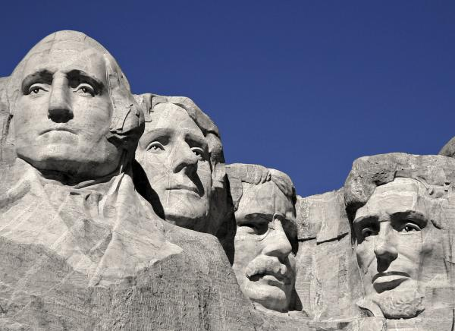
If you read the biographies of great
men one thing is common among all of
them; the ability to persist, the ability
to act and move on with their work in
the face of difficulties and challenges.

Slide 4

Most of us read lots of books have loads of ideas but rarely take any
action on the information. There is a famous saying ‘Knowledge is
Power’ but only applied knowledge is real power’.

Slide 5

Many of us do
not take any
action at all!!!

Slide 6

We procrastinate; we talk
ourselves out of taking any
action on a new idea. We find
a hundred different ways as
to why a new idea will not
work. We keep waiting for the
perfect moment to start a
new business or get going
with the new idea.

Slide 7

We wait till all the things fall
in place and the conditions
are perfect. All these lead to
inactivity, indecision and an
indefinite delay in pursuing
our dreams and ideas.

Slide 8

The giants of the human race
have been men of action. The
ability to persist until a task
is done is what distinguishes
them from ordinary mortals.

Slide 9

A man who acts consistently is sure to succeed.
Whether to start a business, to reach to the top
of your organization, to invent something or to
learn a new skill start taking action today.

Slide 10

A step taken in the right direction
towards your goal no matter how
small is never in vain.

Slide 11

A man of action might fail, but
if you keep acting consistently
sooner or later you will reach
your goal though checkered by
failures and disappointments.

Slide 12

If you do not want to fail then do not
take any action. If you are content being
where you are then there is no need for
any action, but the greatest failure in
life is to have not failed at all.

Slide 13

Consistency is crucial for success.

Slide 14

Many of us are good at
accomplishing short term
goals. Many of us are good
at winning the short races.
We set a goal, work on it
for a few days and then
forget all about it.

Slide 15

But life is not a 100 meter dash, it’s
a marathon which requires consistent
action to achieve success and mastery in
the chosen field. This is where Action’s
brother persistence comes into play.

Slide 16

You should have your vision,
goals, dreams continuously in
front of your eyes and persist
for days or months or even
years till you reach them.

Slide 17

Stay hungry for success; look
out for any small opportunity
that might help you succeed.
Never give up, an attitude that
is an absolute for success, the
road to success is paved with
failure, no wonder that so
many fail and few succeed.

Slide 18

You will also fail, Failure is
inevitable, but every time you
fail, blaming and cursing will not
help. Separate the emotions and
take a look at the failure, analyze
the reason for the failure and
learn from it and move on.

Slide 19

Do you spend hours practicing your
skills and polishing them or do you
just sit and dream your time away.

Slide 20

It is said the journey of a thousand
miles must begin with a single step. Take the first step; the first steps
are generally the hardest. Take the
plunge, take the baby steps, move
forward if only a few inches.

Slide 21

Taking action consistently is hard, but once you make it
a habit and start taking action everyday, you are sure
to achieve your dreams and goals!!!

Slide 22
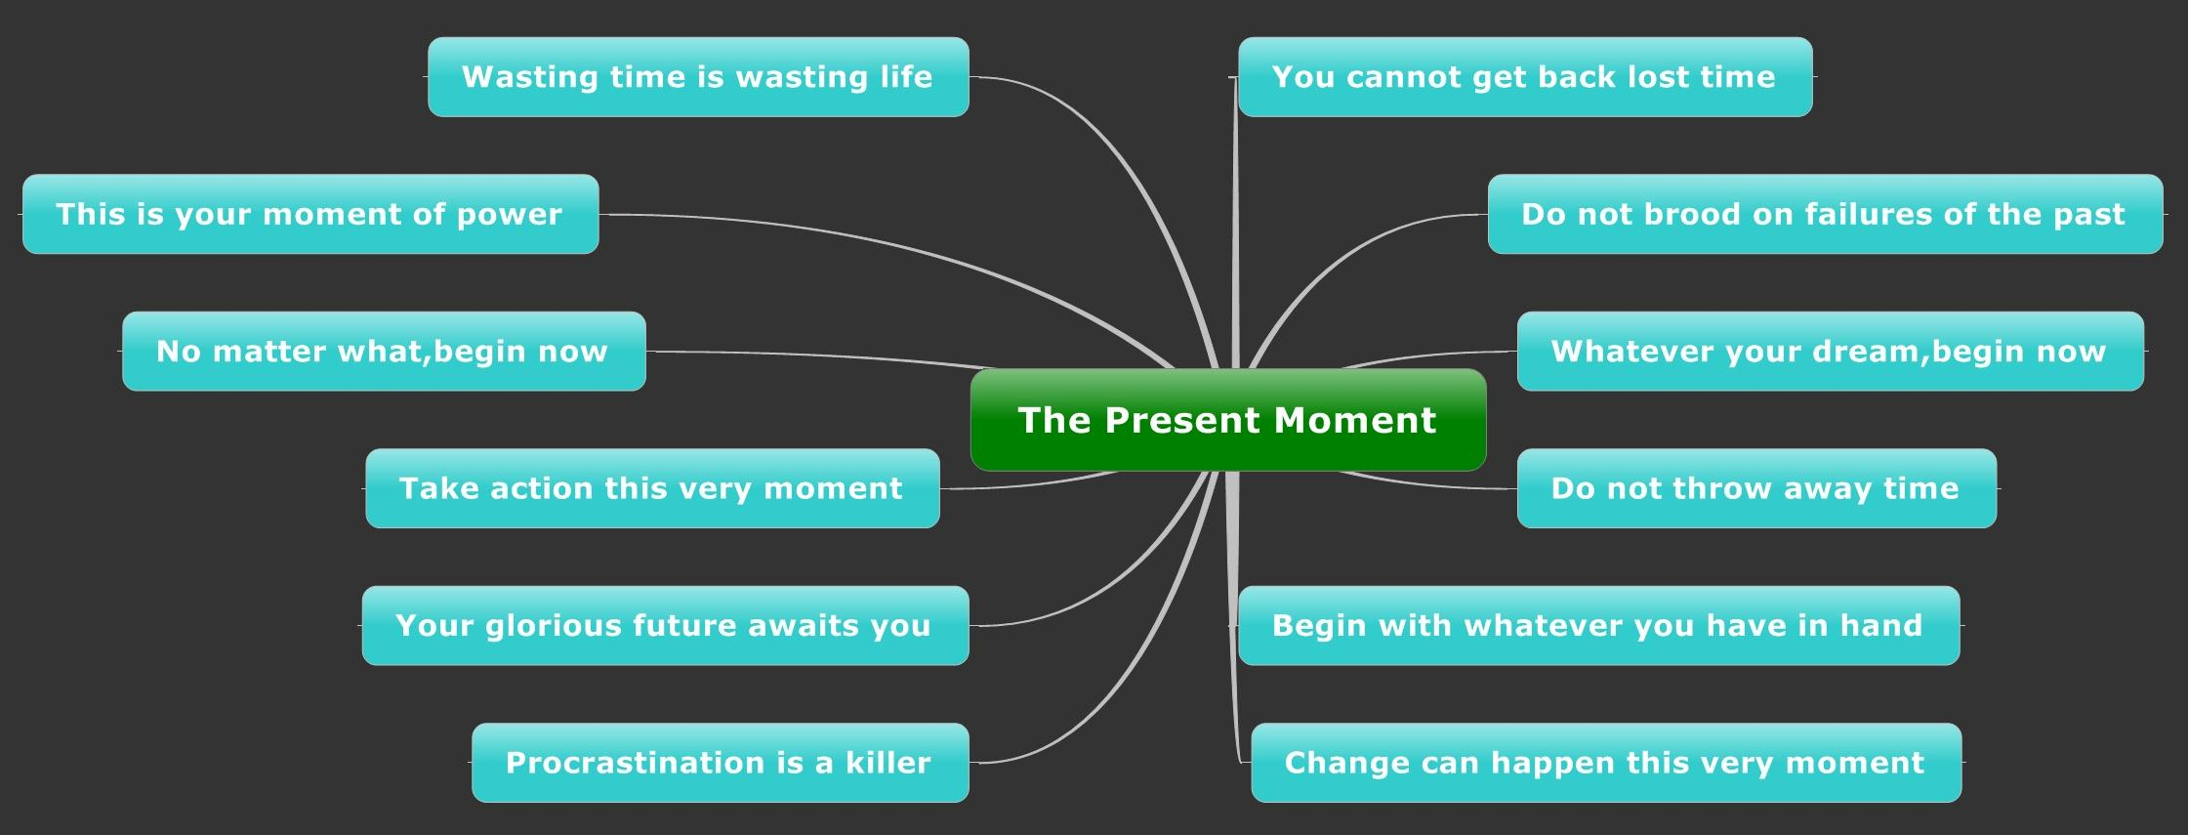
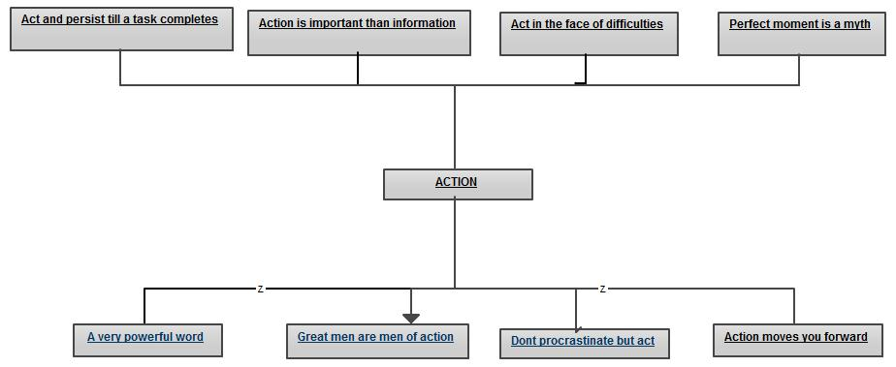
Summary Of Thoughts

