Slide 1
WEBINAR BY SENIOR ADVOCATE MR. RAMESH GUPTA
CROSS EXAMINATION IN CRIMINAL CASES:
A Practical
Analysis of Common Mistakes that Lawyers Make

Slide 2
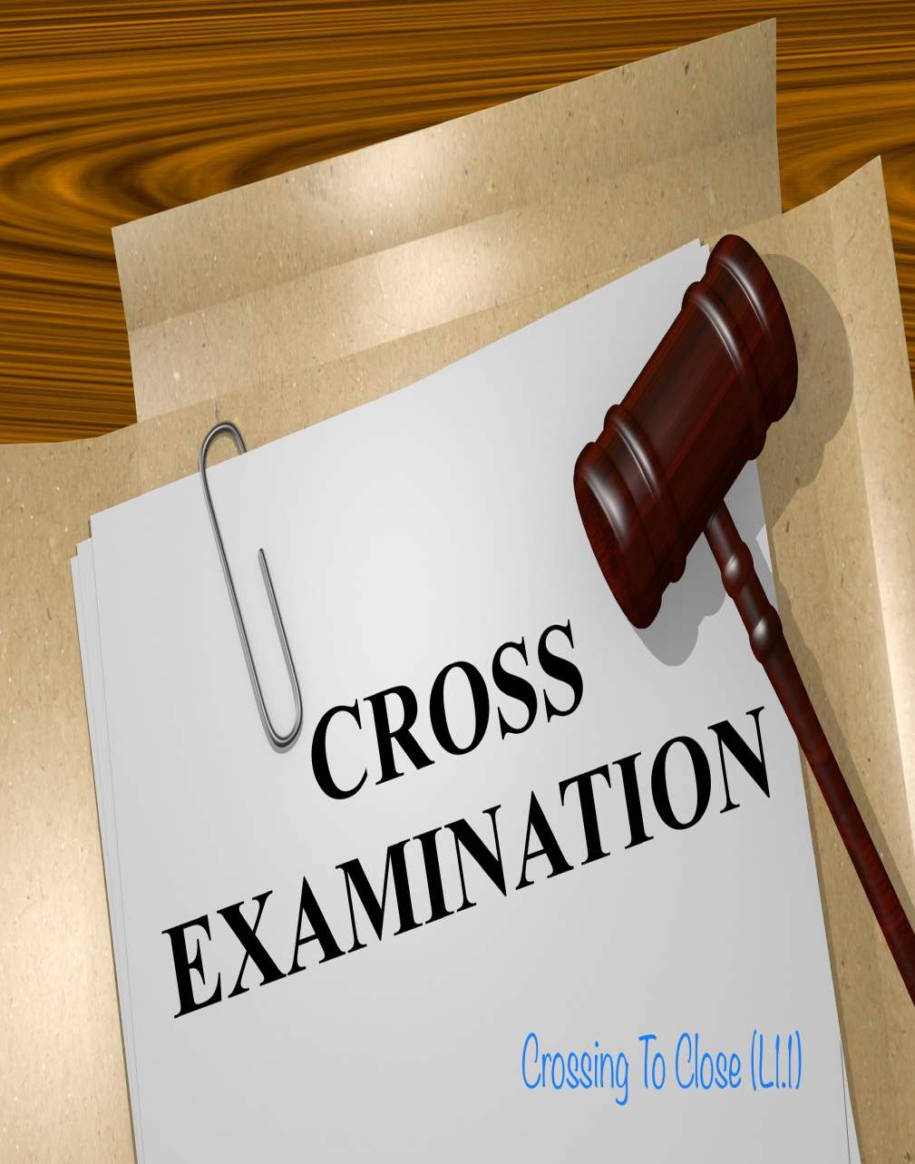
Cross-examination is not just an art but its also a science. This practice is not based on our whims and fancies but is based on laws.

Slide 3
WHAT IS EVIDENCE?
Evidence has been defined under s.3 of the Indian Evidence Act, 1872.
“Evidence” means and includes—
(1) all statements which the Court permits or requires to be made before it by witnesses, in relation to matters of fact under inquiry, such statements are called oral evidence.
(2) all documents including electronic records produced for the inspection of the Court, such documents are called documentary evidence.
Hence there two types of evidence: oral and documentary. Onus of the prosecution/complainant is graver than accused/defendant to prove beyond reasonable doubt.
Onus on defendant is less if he shows any probability of his innocence. If the defense is able to put even a slight dent to the prosecution’s case, then benefit of doubt can be applied to formers case. But law says that the doubt should not be fancy but should be strong and realistic.

Slide 4
WHAT TOOLS ARE AVAILABLE WITH THE DEFENSE
The investigation is started by the police and charge sheet is filed after collection of evidence. During this whole process the accused is not involved anywhere. After collection of evidence a charge sheet is filed and the accused can be put into custody. Police does not consider any thing said by the accused so as to show that he is innocent and therefore the defense evidence comes at the latter stages of the trial.
The Supreme Court in Bahubai vs State of UP has stated that “Conduct of proper and fair investigation is the hallmark of any criminal investigation” and that IO should collect evidence either in favor of accused or complainant. So, we can move an application before the filing of charge sheet that IO shall collect evidence.

Slide 5
TYPES OF EVIDENCE
Oral evidence:
When the proof is restricted to spoken words or by gestures or motion then it is termed as oral evidence.
Oral evidence, when reliable, is adequate without narration or written proof to demonstrate a reality or fact.
Section 59 and 60 of the India Evidence Act mainly deals with oral evidence.
Statements under Section 164 and 161 of CRPC are previous statements of a witness and so they are inadmissible if recorded during investigation.
Anything that can be seen, smell, heard, those evidence are also admissible in court of law, by the oral admission of the person. Although, hearsay statement is not admissible. Under hearsay evidence, the witness tells the court about what he had heard from somebody but has not seen anything or experienced anything by him.

Slide 6
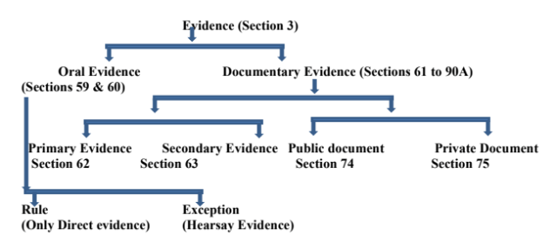

Slide 7
DOCUMENTARY evidence:
Any evidence which is present as a document before the court in order to demonstrate or show a reality.
Sections 61, 62, 63 deal with primary and secondary evidence.
Primary evidence is considered as the evidence which is given in several parts like duplicate copies or as counterpart like those which is signed by the parties or photocopy of the document whereas,
Secondary evidence contains certified copies, that have been made by the same mechanical process and also contain counterparts of the document against the parties.

Slide 8
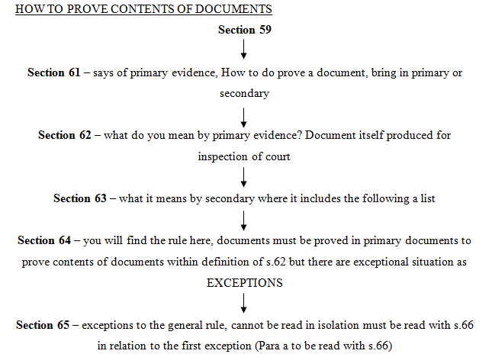

Slide 9
CAN EXAMINATION IN CHIEF OF A PERSON WHOSE CROSS HAS BEEN CONDUCTED BE TERMED AS ORAL EVIDENCE?
No, unless his evidence is complete, that is examination-in-chief along with cross examination, and then witness is discharged, then only that evidence will be termed as evidence.
When a statement is recorded under s.164 of a witness and that witness fails to appear in court, the statement won’t be termed as evidence since it is a past statement.
Hence, statement under s.164 has no evidentiary value unless a victim comes to the court and makes a deposition. Evidence of eyewitness has to be form of examination-in-chief and cross, re-examination.

Slide 10
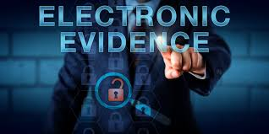
EVIDENCE THROUGH ELECTRONIC MEDIUM
Under the Indian Evidence Act, s.65A and 65B deals with evidence in electronic format.
The question of admissibility of electronic evidence was first raised in the case of
State v. Mohd. Afzal, and then later in the case of State (NCT of Delhi) v. Navjot Sandhu, where the SC held that “even if the requirements under section 65B(4) were not satisfied, evidence could be produced under sections 63 and 65 of the Evidence Act”. But this judgment was overruled by PV Anwar v. PK Basheer where the SC rejected the view taken previously that the sections 61-65 of the Evidence Act can be used when the conditions mentioned under section 65B were not met.
The Court applied the principle of generalia specialibus non derogant. Therefore, the Court held that while sections 61-65 deal with the general documentary evidence, section 65B refers to one special component- electronic records. Therefore, it was held that electronic evidence can only be dealt with under section 65B.

Slide 11
Under s.118 of the Evidence Act it is stated that,
“All persons shall be competent to testify unless the Court considers that they are prevented from understanding the questions put to them, or from giving rational answers to those questions, by tender years, extreme old age, disease, whether of body or mind, or any other cause of the same kind. A lunatic is not incompetent to testify, unless he is prevented by his lunacy from understanding the questions put to him and giving rational answers to them.”
Hence, even a child witness can give evidence if he understands the circumstances.

Slide 12
CODE OF CRIMINAL PROCEDURE
S.162 deals with examination of witness by police.
S.162 talks about statements to police not to be signed and use of statements as evidence.
An important part in the section is “ provided, at any inquiry or trial in respect of any offence under investigation at the time when such statement was made: Provided that when any witness is called for the prosecution in such inquiry or trial whose statement has been reduced into writing as aforesaid, any part of his statement, if duly proved, may be used by the accused, and with the permission of the Court, by the prosecution, to contradict such witness in the manner provided by section 145 of the Indian Evidence Act, 1872 (1 of 1872 ); and when any part of such statement is so used, any part thereof may also be used in the re- examination of such witness, but for the purpose only of explaining any matter referred to in his cross- examination”.
Any statement which has been reduced to writing which has been given by a witness under 161 or any other statement, it is called a previous statement. S.162 shows how to use section 161 or 145. Statements recorded by SGMs can also be termed as previous statement. And their confrontation will be according 162 of Evidence Act.

Slide 13
DELHI HIT AND RUN CASE
In early morning of 10th January, a car hit around 5-6 people. The car was speeding and later the car was traced with the help of number plate.
An FIR was filed eventually. After 5 days an eyewitness comes up. Now the problem was that Prosecution was unable to show that accused Sanjeev was actually driving the car. Defense could take the defense either that yet he was driving, by they were the ones who were standing on the road or they could take the defense that Sanjeev was not driving the car at all so that the onus shifts on the prosecution to prove that Sanjeev was driving.
The defense adopted the later scenario as it was better to accept since the car at the scene of crim clearly belonged to the accused. The eyewitness was dropped eventually, and the trial went on.
The prosecution tried to weave a story of the accused getting out of the car and examining the scene but this whole assumption was demolished by the defense counsel.
Police tend to introduce eyewitnesses’ weeks and days later which usually mean that they are false eyewitnesses.In accident cases site plan plays an important role. The positioning of eye witness should be seen on the site plan and then cross should be done.

