Slide 1

Pascal Comvalius MSc.
IMI-Certified Mediator
MFN-Registered Mediator (Family, Divorce & Criminal Law)
Certified Hostage / Crisis Negotiator
Chair IMI Appraisal & Audit Committee
Suicide Prevention Gatekeeper

Slide 2
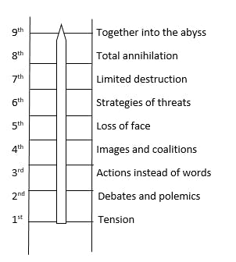


Slide 3
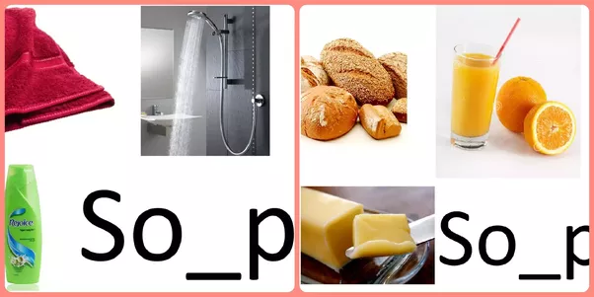
How Bias manifests Itself
Priming Effect
An implicit memory effect in which exposure to on a stimulus influences the response to another stimulus

Slide 4
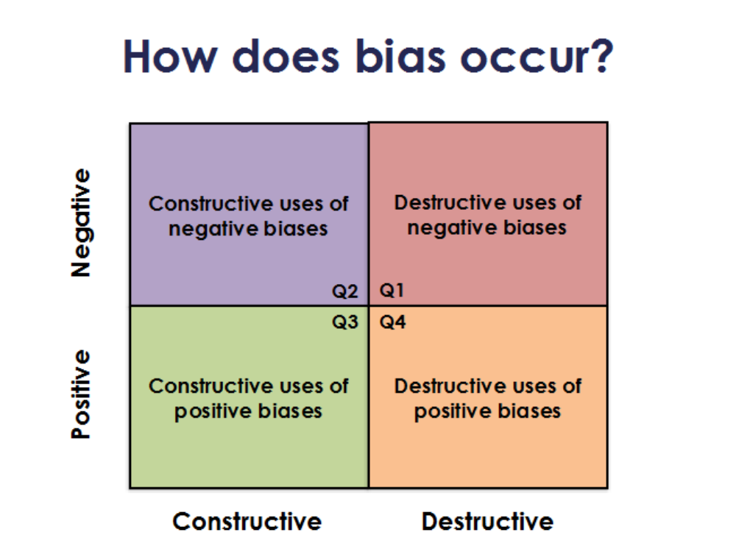
Bias

Slide 5
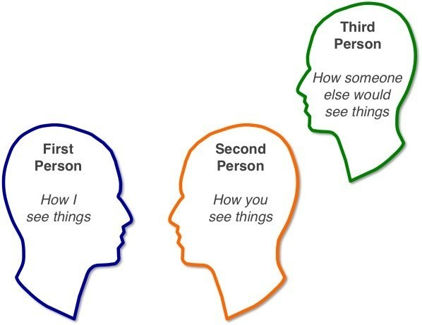
Four Perceptual Positions
Fourth Person

Slide 6
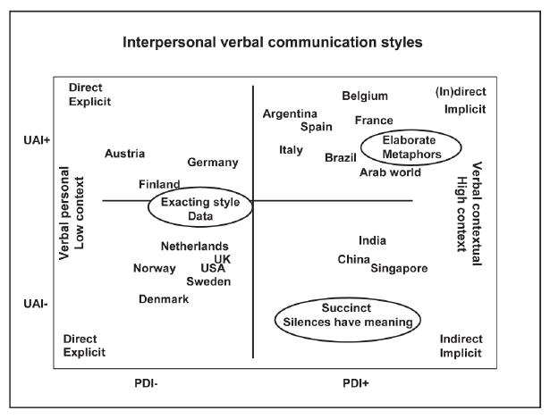
Verbal Style In High
And Low Context

Slide 7
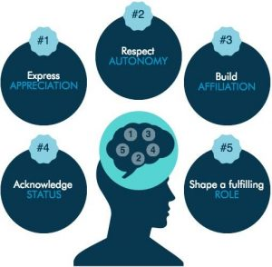
Five Core Concerns Negotiation

